Slide 1
BUDGETING USER TRAINING
Client logo
SUBHEAD HERE

Slide 2
Agenda
Lesson 1 – Getting Started
Lesson 2 – Budget Process Overview
Lesson 3 – Working with Budgets
Lesson 4 – Review and Submit
Lesson 5 – Publish Budget Plan Files
Wrap Up

Slide 3
Course Objectives
By the end of this class, you should be able to:
Log in to Axiom Budgeting
Complete each worksheet in your budget workbook
Review and submit budget for approval

Slide 4
Getting Started
Lesson 1

Slide 5
Lesson 1 Objectives
By the end of this lesson, you should be able to:
Log into Axiom
Understand the difference between Windows and Excel Client
Open the Budget User Admin Task Pane
Open, close, and save a budget plan file
Navigate between worksheets in budget plan file
Identify which cells can be changed, based on color coding

Slide 6
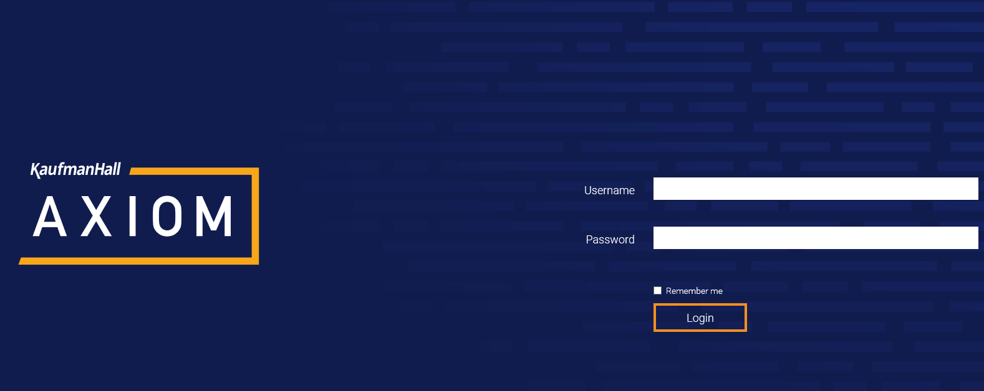
LESSON 1: GETTING STARTED
Accessing Axiom

Slide 7
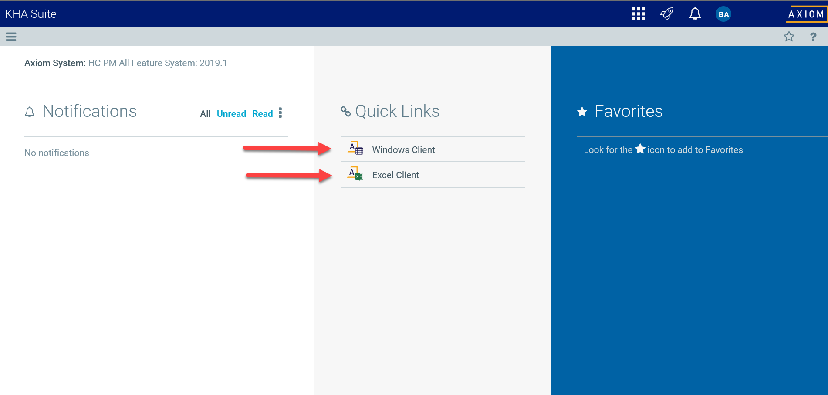
LESSON 1: GETTING STARTED
Selecting Windows vs Excel Client

Slide 8
Database
Spreadsheets
User

Slide 9
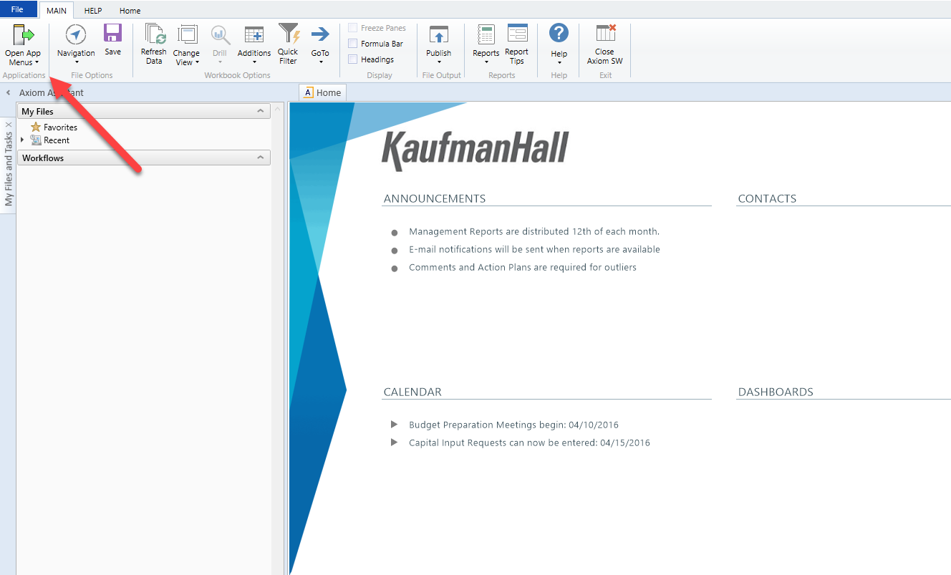
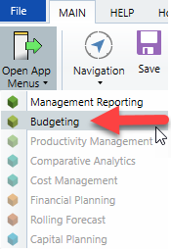
LESSON 1: GETTING STARTED
Open Application Menu to select the “Budgeting” Task Pane

Slide 10
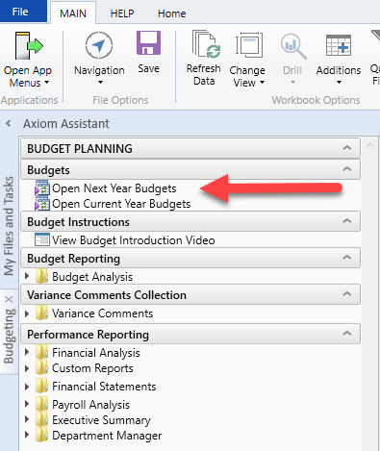
LESSON 1: GETTING STARTED
Open Next Year Budget Plan Files from the “Budgeting” Task Pane
What is the difference between:
Next Year Budgets
Current Year Budgets

Slide 11
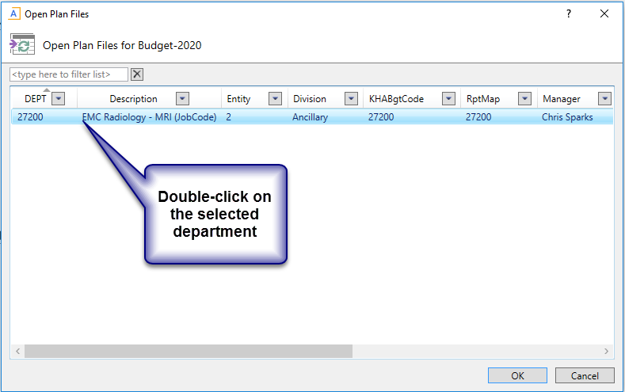
LESSON 1: GETTING STARTED
Open selected Budget Plan File
Security allows you to see only the departments you are responsible to budget

Slide 12
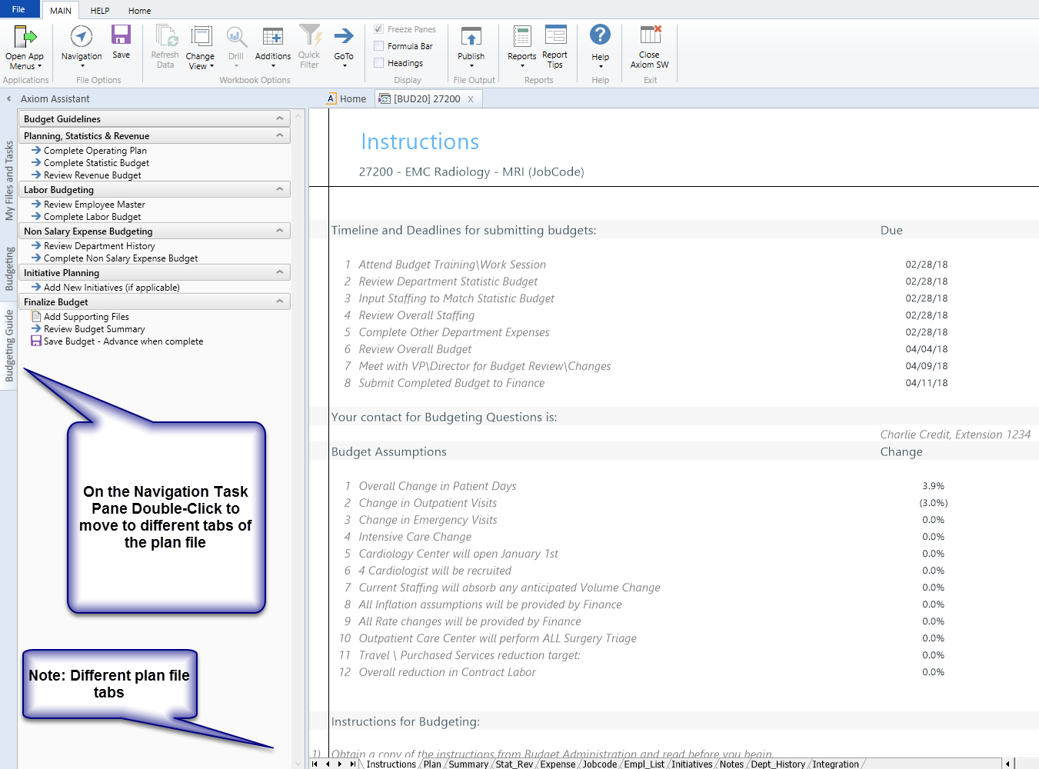
Review “Budget Guide” Task Pane
LESSON 1: GETTING STARTED
The Budget Guide Task Pane has hyperlinks to each section of the plan file where you complete your budget work.
The Budget Guide Task Pane steps are in the order that Kaufman Hall considers “Best Practice” to complete your plan file.

Slide 13
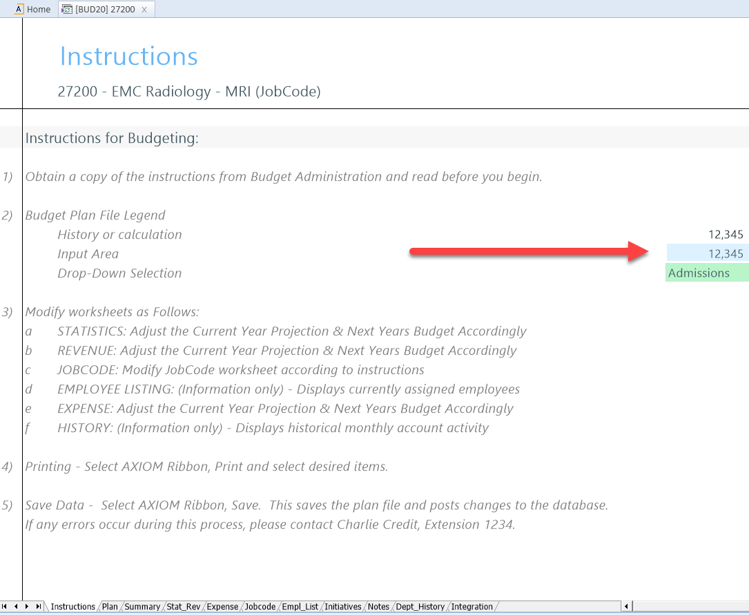
Budget Plan File Legend
LESSON 1: GETTING STARTED
Cells in the Budget Plan File have three colors:
White – Protected Cells that can not be altered.
Blue – Cells where you can key in your work.
Green – A pick list to select your options.

Slide 14
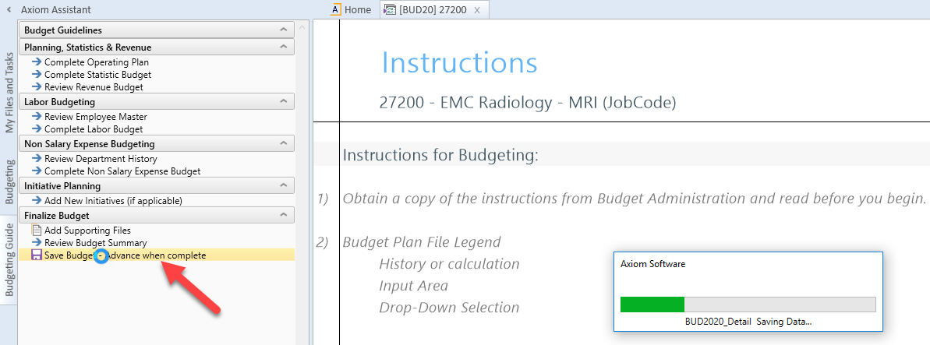
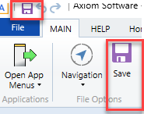
Saving a Plan File
LESSON 1: GETTING STARTED
There are multiple options to save a plan file:
From the Budgeting Guide Task Pane
From the Main Menu
From the Quick Access Toolbar

Slide 15
Review Questions
LESSON 1: GETTING STARTED
What are the two access points into Axiom:
Windows Client
Excel Client

Slide 16
Review Questions
LESSON 1: GETTING STARTED
What task pane do you open to access your plan files?
Budgeting

Slide 17
Review Questions
LESSON 1: GETTING STARTED
What year are you accessing when you select the Next Year versus the Current Year Budgets?
Next Year
Current Year

Slide 18
Review Questions
LESSON 1: GETTING STARTED
How can you navigate between the tabs of the plan file?
Budgeting Guide Task Pane
Point and Click

Slide 19
Review Questions
LESSON 1: GETTING STARTED
What does it mean when a cell has:
white shading
blue shading
green shading

Slide 20
Recap
LESSON 1: GETTING STARTED
You should now be able to:
Log in to Axiom
Open the Budgeting Task Pane
Identify which cells can be changed, based on
color coding
Open, close, and save a budget plan file

Slide 21
Questions?

Slide 22
Budget Process Overview
Lesson 2

Slide 23
Lesson 2 Objectives
By the end of this lesson, you should be able to:
Understand the purpose of each tab in a budget workbook
Understand the time series that interface into the plan files
Understand the Budget methods assigned to a revenue or expense account

Slide 24

LESSON 2: BUDGET PROCESS OVERVIEW
Budget Plan file tabs

Slide 25
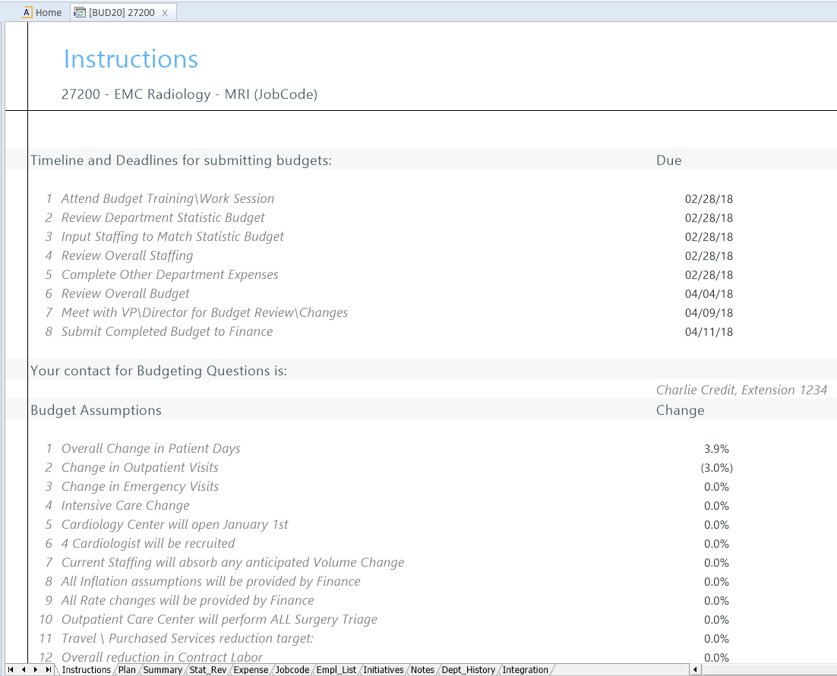
Instructions Tab
LESSON 2: BUDGET PROCESS OVERVIEW
The Instructions tab of a plan file is populated based on dates and assumptions made by your Budget Administrator.
This tab is for informational purposes only.
There is no work for you to do on this tab.

Slide 26
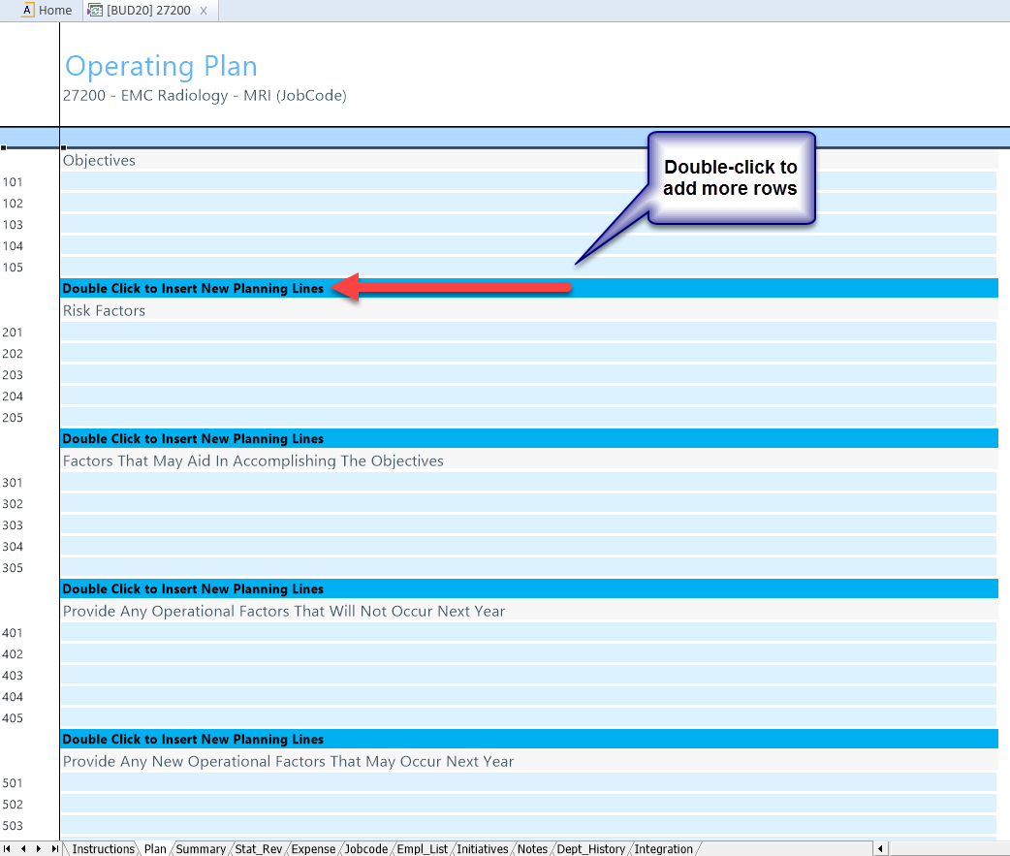
Plan Tab
LESSON 2: BUDGET PROCESS OVERVIEW
The Operating Plan tab is an optional tab that is turned on or off by your Administrator.
These questions are populated by your Budget Administrator as directives from your Finance Team.
You can add as many rows as you need to answer the questions in this tab.
Your answers save to the database.

Slide 27
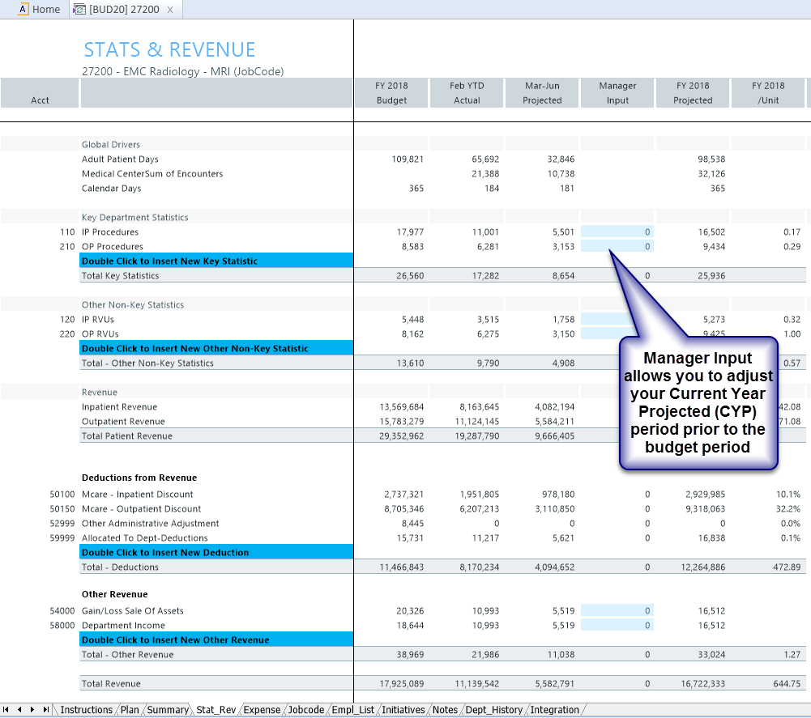
Stat_Rev Tab
LESSON 2: BUDGET PROCESS OVERVIEW
The Stat_Rev (Statistics and Revenue) tab is where you budget your department statistics, patient revenue, other revenue and deductions at an account level.
Historical data interfaces into this tab and current run rates plus assigned calculation methods (CM) create your projections for your budget.
Blue and green cells are areas where you can make adjustments in the plan file.

Slide 28
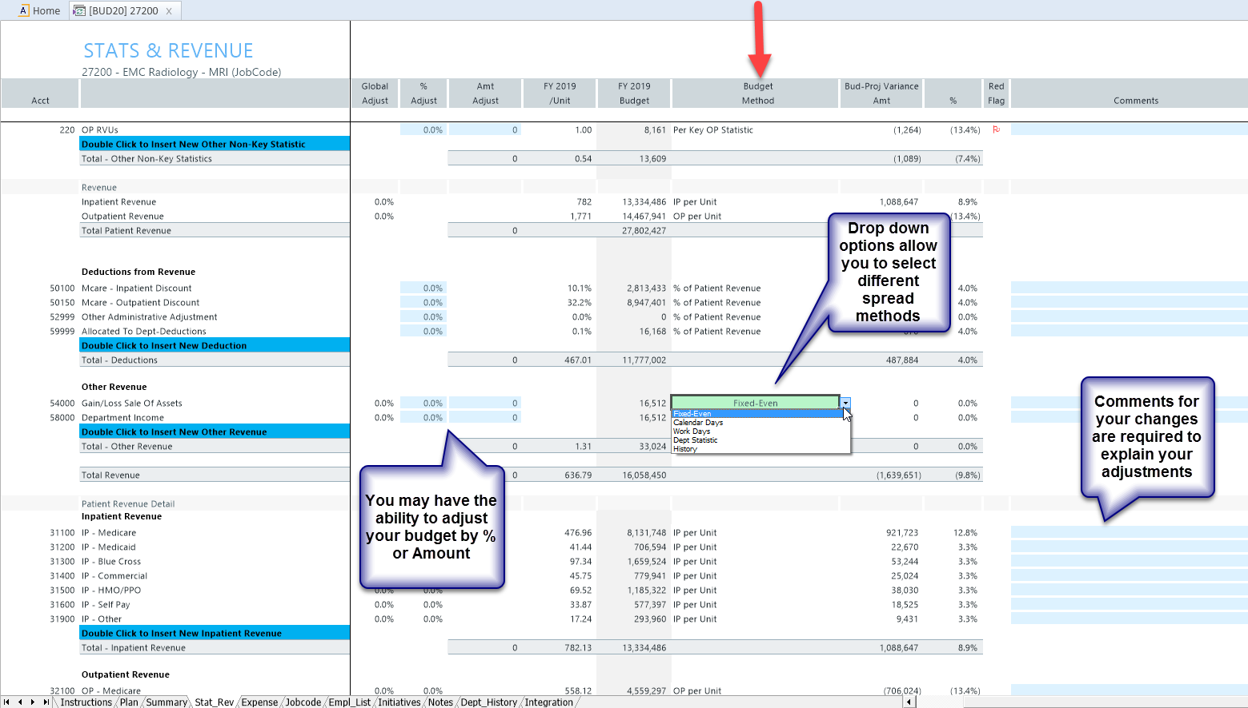
Stat_Rev Tab
LESSON 2: BUDGET PROCESS OVERVIEW
Budget Methods (aka Calc Methods) are pre-defined calculations that your Budget Administrator defined for each account.
Some CMs allow for different spreading for your next year budget. Other CMs spread your monthly budget based on your statistics spread

Slide 29
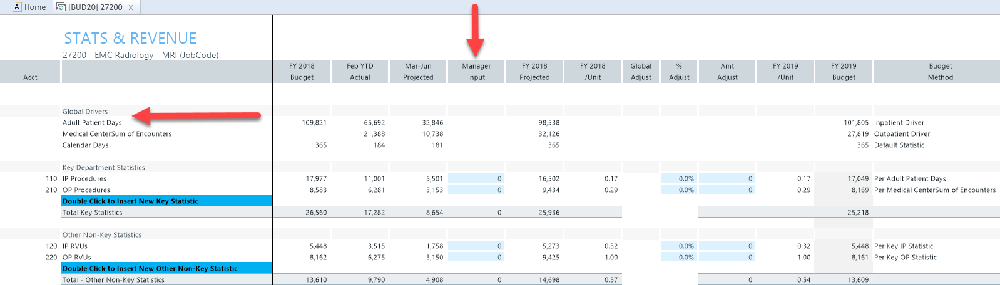
Stat_Rev Tab
LESSON 2: BUDGET PROCESS OVERVIEW
Global Drivers are Entity Level Statistics (Patient Days, Discharges, Calendar Days) that are used to temper your key department statistics when projected for budget.
Note: Global Drivers are managed by your Administrator. You will not be able to adjust the Global Drivers.

Slide 30
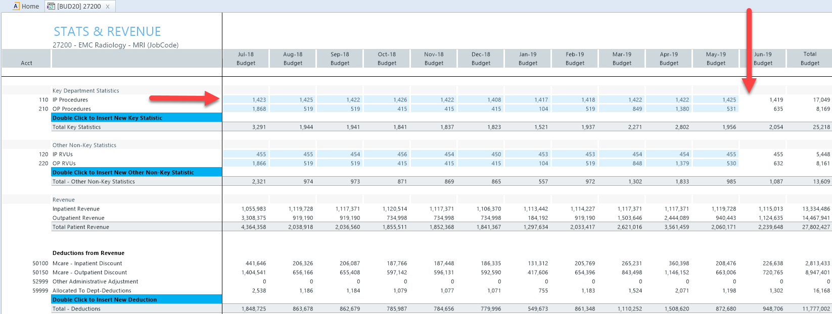
Stat_Rev Tab
LESSON 2: BUDGET PROCESS OVERVIEW
Depending on your Administrator setup, you may or may not be able to adjust your monthly statistics. If the cells are blue, you can make monthly adjustments.
Note: The final month of the budget year will be a plug, so make sure there are no negatives in the last month.

Slide 31
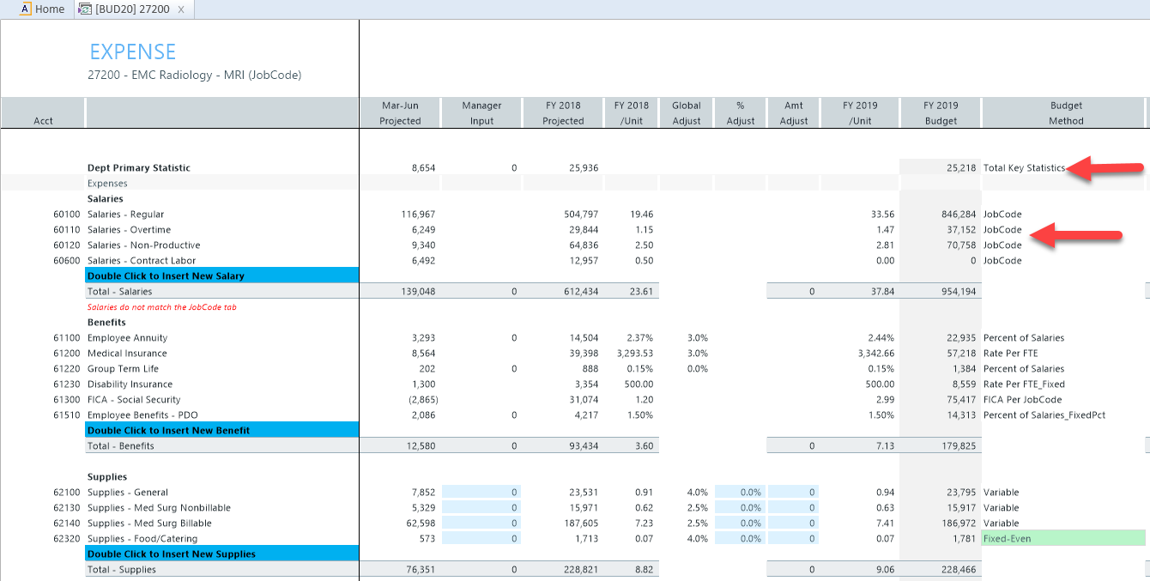
Expense Tab
LESSON 2: BUDGET PROCESS OVERVIEW
The Expense tab is where you budget all department expenses, except salaries.
Salaries calculations come from the Labor tabs (JobCode, Staffing, Employee).
Total Key Statistics are used to drive variable expenses.

Slide 32
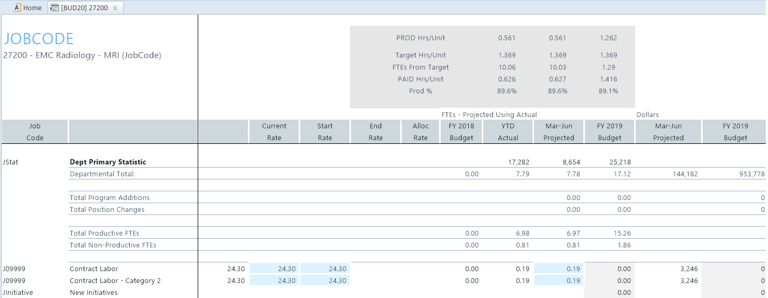
Labor Tabs
LESSON 2: BUDGET PROCESS OVERVIEW
The JobCode tab is one example of a labor tab where you can budget salaries.
Total Key Statistics are used to drive variable expenses.

Slide 33
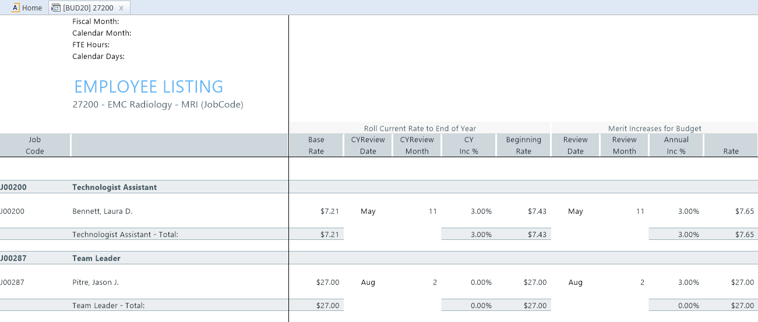
Empl_List Tab
LESSON 2: BUDGET PROCESS OVERVIEW
The Employee List tab, is a reference for the payroll tab.
Note: No work is done here

Slide 34
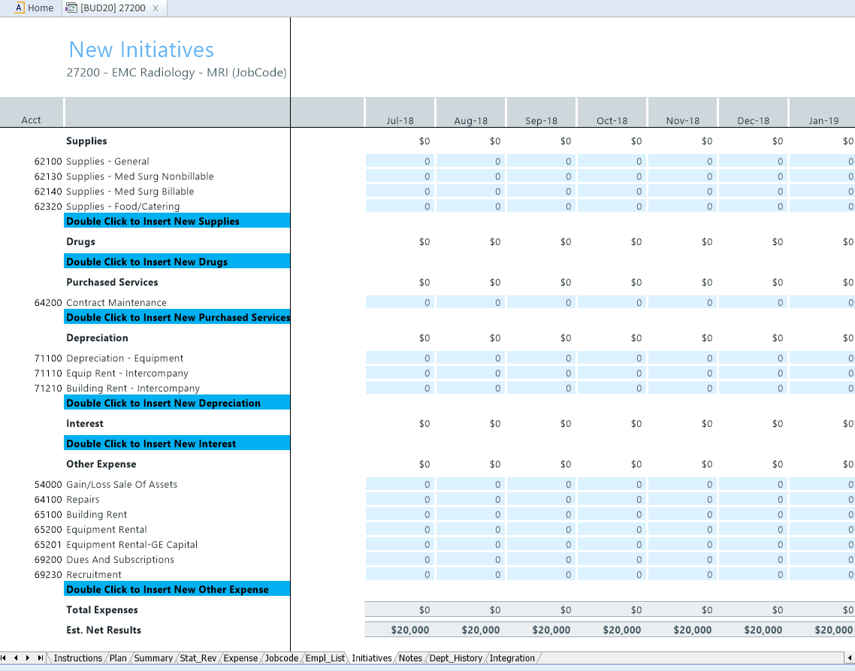
Initiatives Tab
LESSON 2: BUDGET PROCESS OVERVIEW
The Initiatives tab can be used to layer on strategic initiatives.
Once built into your plan file, Initiatives can be easily included or excluded from your budget with the flip of a switch.
Multiple initiatives can be added to your department plan file.

Slide 35
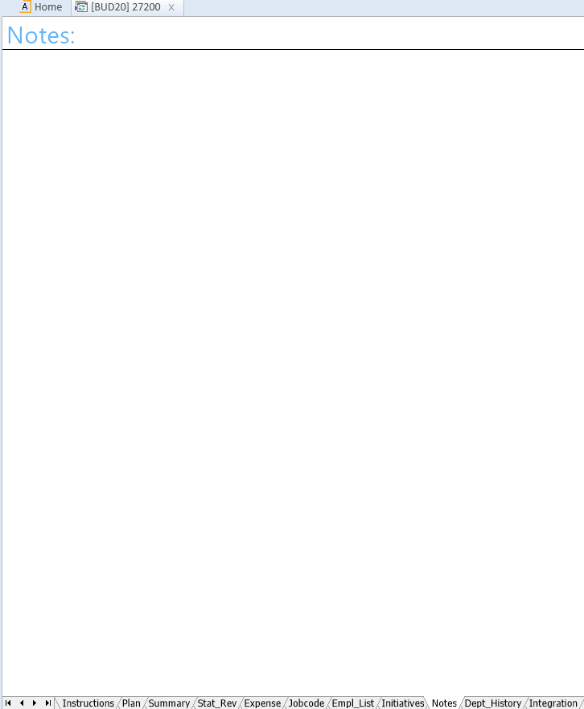
Notes Tab
LESSON 2: BUDGET PROCESS OVERVIEW
The Notes tab is a free-form space for entering reference notes.
Note: This is the only tab where we can enter information into white cells.

Slide 36
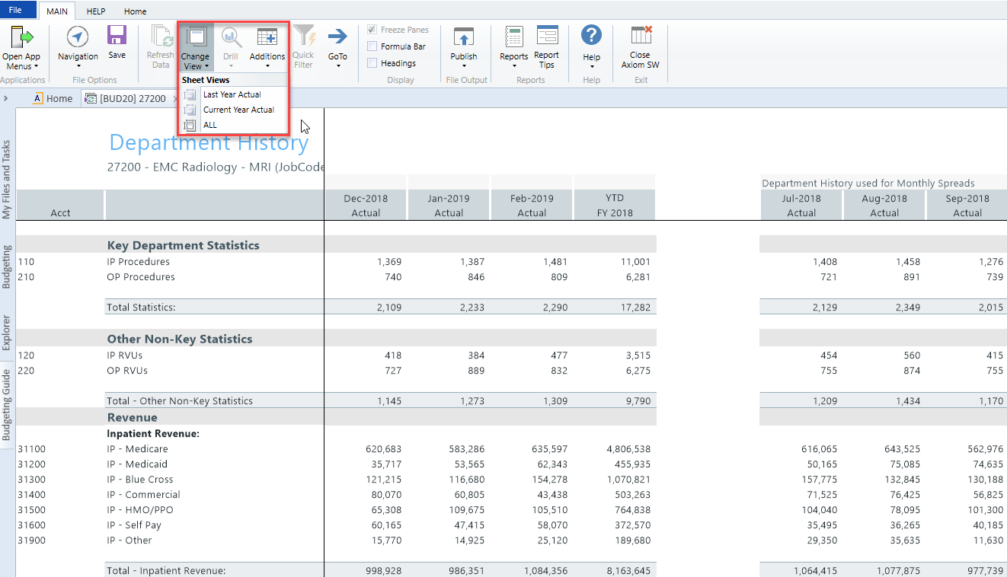
Dept_History Tab
LESSON 2: BUDGET PROCESS OVERVIEW
The Department History tab is another reference tab that provides historical data for the last year and current year.
It also has a view that displays the Rolling 12 months used for that spread method calculation.

Slide 37
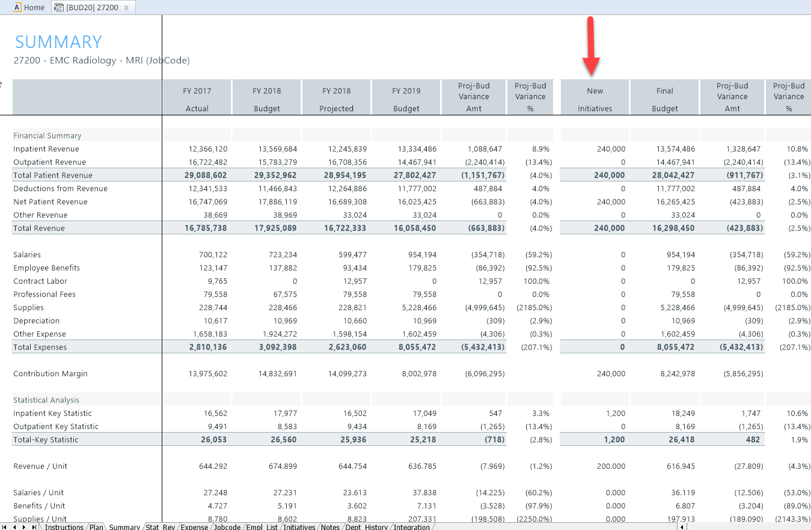
Summary Tab
LESSON 2: BUDGET PROCESS OVERVIEW
The last step of your budget process is to review your results in the Summary tab.
This tab cannot be edited as it pulls data from the other tabs.
It is “best practice” to review this tab for variance analysis and ensure you did not miss any categories.

Slide 38
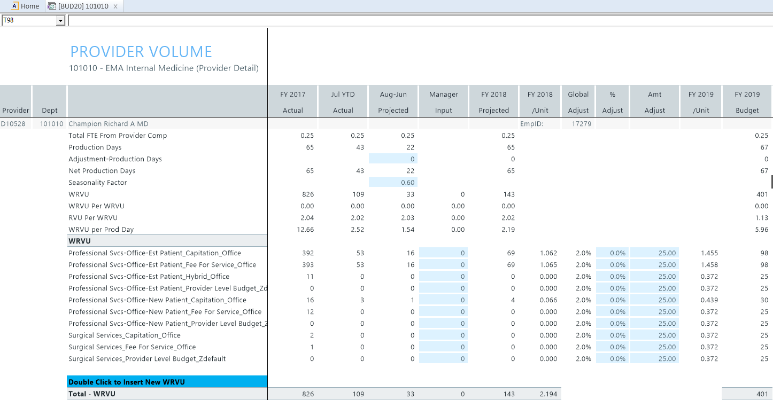
Provider Tab
LESSON 2: BUDGET PROCESS OVERVIEW
The Provider tab allows you to budget volumes and charges by provider.

Slide 39
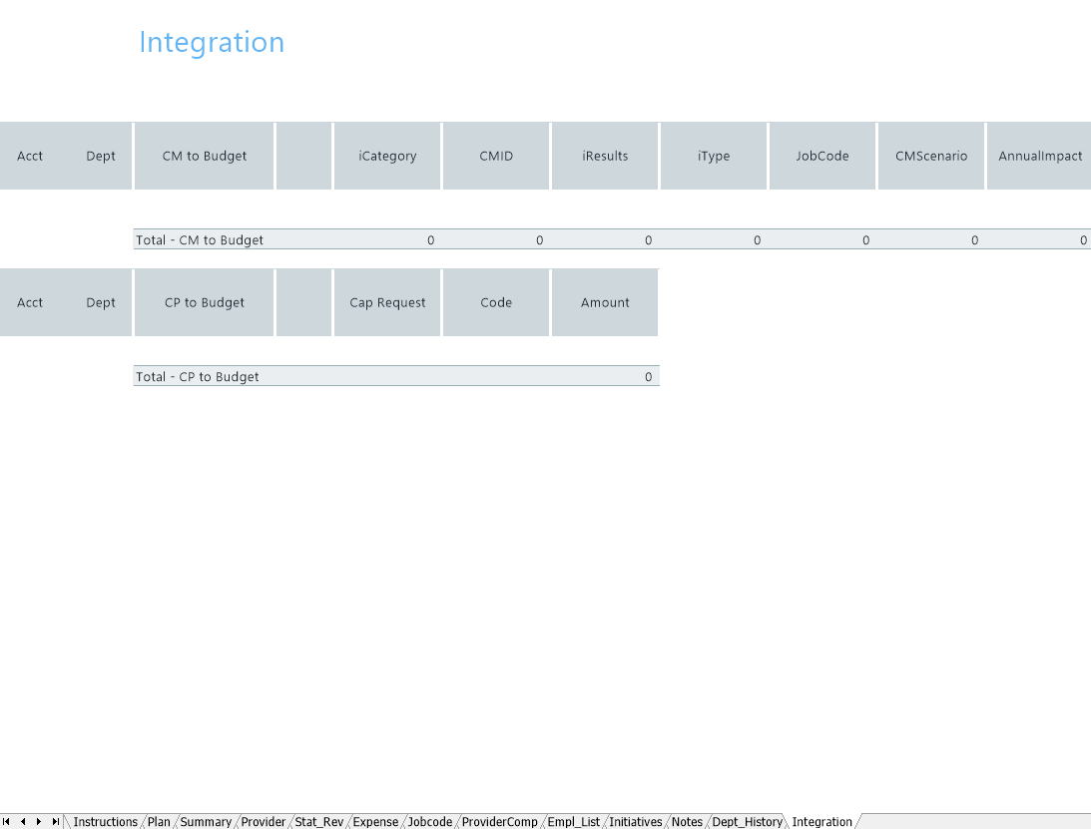
Integration Tab
LESSON 2: BUDGET PROCESS OVERVIEW
The Integration tab allows you to pull in data from other licensed modules such as Capital Planning or Cost Management.

Slide 40
LESSON 2: BUDGET PROCESS OVERVIEW
Checklist
Verify/edit all blue cells
Review Current Year Projections
Make manager adjustments
Review the Next Year Budget – totals and monthly spreads
Explain variances by adding comment on each line with a red flag

Slide 41
Review Questions
LESSON 2: BUDGET PROCESS OVERVIEW
What tab houses the Revenue and Statistics?
What tab do I use to work on FTEs and payroll?

Slide 42
LESSON 2: BUDGET PROCESS OVERVIEW
Review Questions
What’s the purpose of the Detail Calc Method?
Notes:
SPM

Slide 43
LESSON 2: BUDGET PROCESS OVERVIEW
Review Questions
What kinds of expenses can we adjust on the Expense worksheet?
Notes:
That the value exceeds varaince threshold and requires comment\

Slide 44
LESSON 2: BUDGET PROCESS OVERVIEW
Review Questions
What does a red flag mean?
Notes:
That the value exceeds varaince threshold and requires comment\

Slide 45
Recap
LESSON 2: BUDGET PROCESS OVERVIEW
You should now be able to:
Understand the purpose of each tab in a budget workbook
Understand the time series that interface into the plan files
Understand the Budget methods assigned to a revenue or expense account

Slide 46
Questions?

Slide 47
Working with Budgets
Lesson 3

Slide 48
Lesson 3 Objectives
By the end of this lesson, you should be able to:
Enter adjustments
Apply spreading methodologies
Enter detail accounts
Complete payroll worksheet
Budget for new initiatives

Slide 49
LESSON 3: WORKING WITH BUDGETS
Worksheets

Slide 50
LESSON 3: WORKING WITH BUDGETS
Review Questions
What are the spread options for the fixed methodology?

Slide 51
LESSON 3: WORKING WITH BUDGETS
Review Questions
[JobCode] What is the difference between program additions and position changes?
[Staffing] What type of department should use the Staffing template?
[ADC] What type of department should use the ADC template?
[Employee] Can JobCodes be variable on the Employee tab?

Slide 52
Recap
LESSON 3: WORKING WITH BUDGETS
You should now be able to:
Enter adjustments
Apply spreading methodologies
Enter detail accounts
Complete Labor tabs

Slide 53
Questions?

Slide 54
Review and Submit
Lesson 4

Slide 55
Lesson 4 Objectives
By the end of this lesson, you should be able to:
Review your budget for completeness and consistency using the SUMMARY tab.
Advance and return budgets through Process Management

Slide 56
LESSON 4: REVIEW AND SUBMIT
SUMMARY Worksheet

Slide 57
Review Questions
LESSON 4: REVIEW AND SUBMIT
How are the values in the “Final Budget” column different from the “FY(YYYY) Budget” column?

Slide 58
LESSON 4: REVIEW AND SUBMIT
Review Questions
Can changes be made to budgets after they are forwarded to the next approval level in Process Management?

Slide 59
Review Questions
LESSON 4: REVIEW AND SUBMIT
What should you do if you encounter an error during the save process?

Slide 60
LESSON 4: REVIEW AND SUBMIT
Recap
You should now be able to:
Review your budget for completeness and consistency using the SUMMARY tab.
Advance and return budgets through Process Management

Slide 61
Questions?

Slide 62
Printing Budgets
Lesson 5

Slide 63
Lesson 5 Objectives
By the end of this lesson, you should be able to:
Print your budget

Slide 64
LESSON 5: PRINTING BUDGETS
Printing Budgets

Slide 65
Recap
LESSON 5: PRINTING BUDGETS
You should now be able to:
Print your budget

Slide 66
Questions?

Slide 67
Wrap-Up

Slide 68
Kaufman Hall Budgeting User Training
Course Objectives
You should now be able to:
Log in to Axiom Budgeting
Complete each tab in your budget plan file
Save, Print and submit budgets for approval

Slide 69
Budget Process Checklist
Kaufman Hall Budgeting User Training
Refer to the Budget End User Checklist appendix in your handout.

Slide 70
Questions?

Slide 71
Axiom Budgeting User Training
Presented by:
[place client name/logo here]
Client City, State
00/00/00

Slide 72
Thank You!
Client logo

